Slide 1
MLSA Full Stack Web Development Internship Report
Name : GULSHAN TOMAR
University Roll No. : 2300290100114
Section : III - B
Branch : CSE (2023-2027)

Slide 2



TECH STACK USED
HyperText Markup Language (HTML) is the basic scripting language used by web browsers to render pages on the World Wide Web. HyperText allows a user to click a link and be redirected to a new page referenced by that link.
CSS is the acronym of “Cascading Style Sheets”. CSS is a computer language for laying out and structuring web pages (HTML or XML). This language contains coding elements and is composed of these “cascading style sheets” which are equally called CSS files
JavaScript is a scripting language that enables you to create dynamically updating content, control multimedia, animate images, and pretty much everything else.

Slide 3
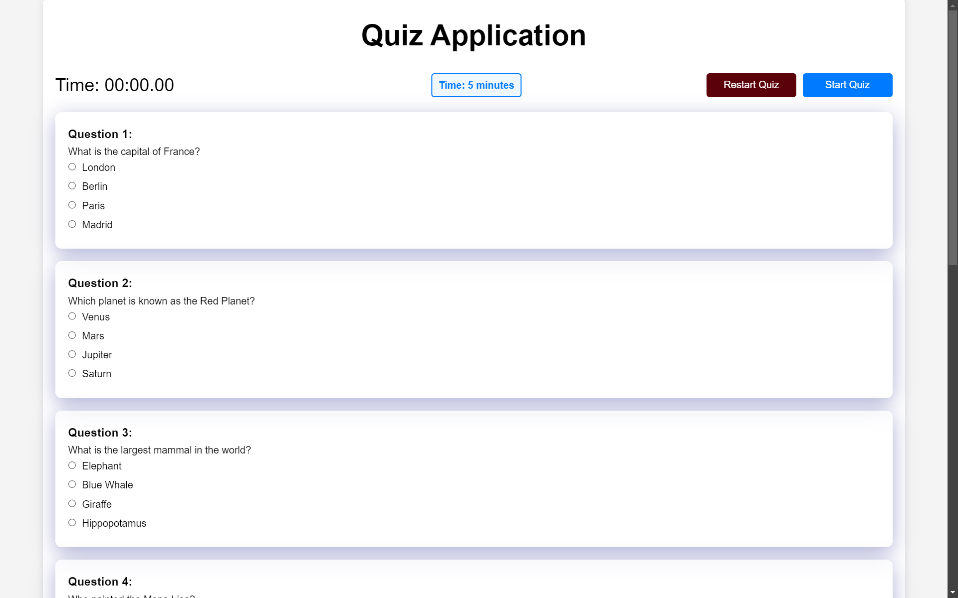
EASY PROJECT : QUIZ APPLICATION

Slide 4
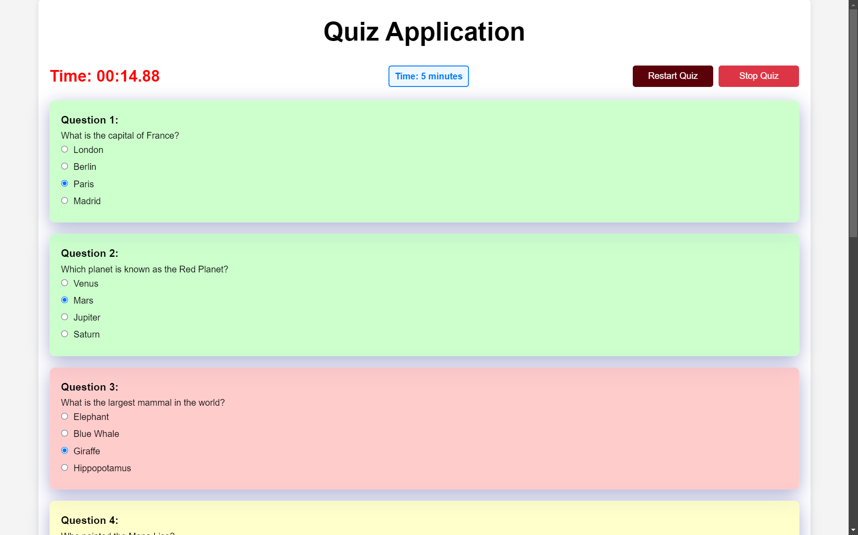

Slide 5
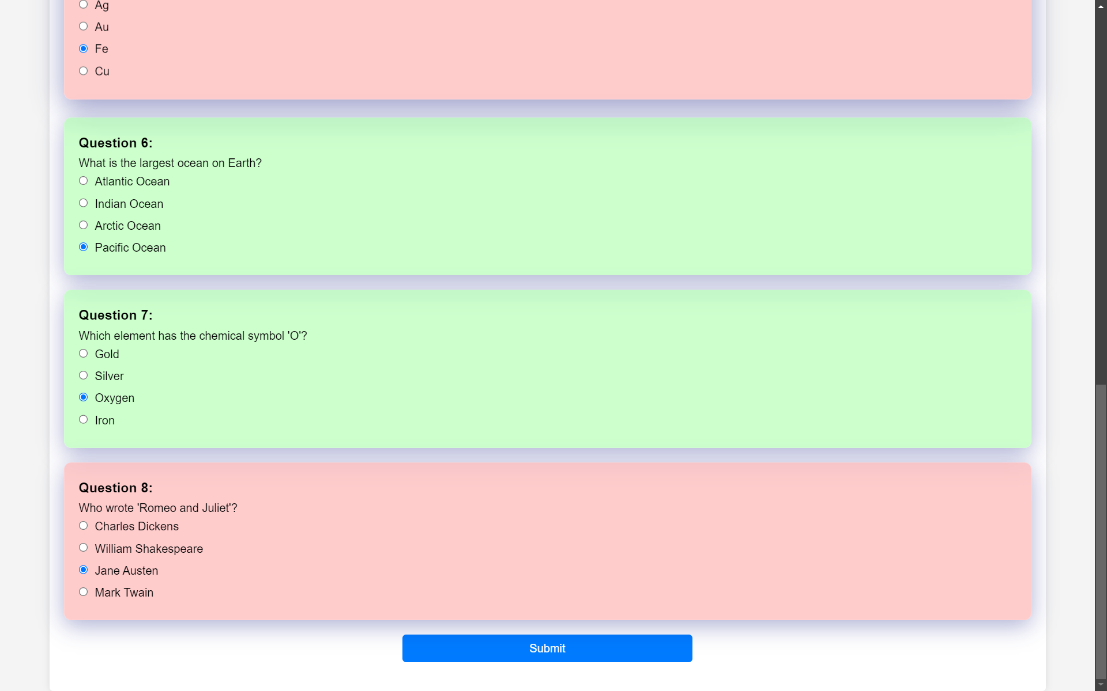

Slide 6
QUIZ APPLICATION FEATURES :
The quiz application is a timed assessment with a duration of 5 minutes, displaying the remaining time for the user to complete it.
It provides a "Restart Quiz" option, allowing users to reset the quiz and attempt it again.
There is also a "Stop Quiz" feature, which likely allows users to exit the quiz before all questions are answered or the time expires.
The application includes a "Submit" button for users to submit their answers when they have completed the quiz.
If the answer is right then its colour changes to green and red if wrong and if it is not attempted then its colour changes to yellow after submitting the quiz.

Slide 7
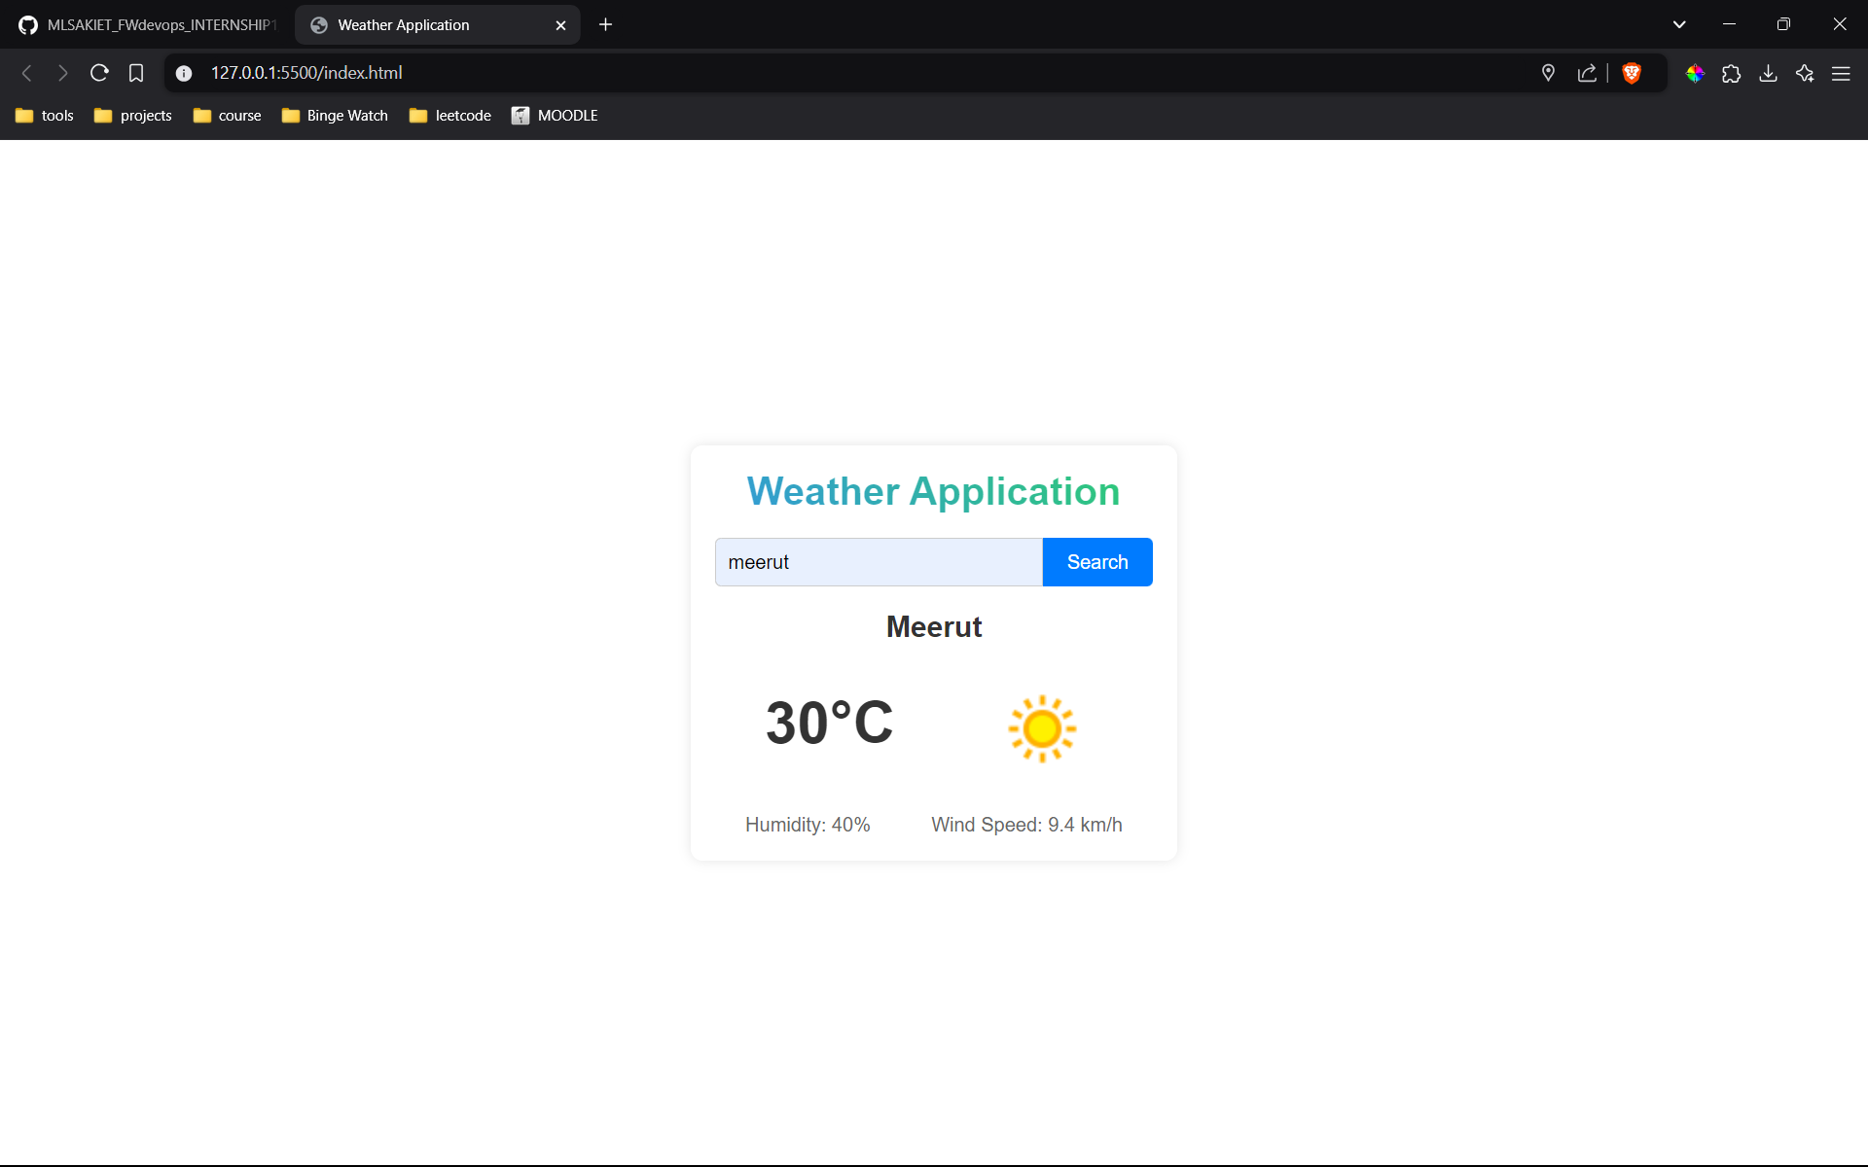
INTERMEDIATE PROJECT : WEATHER APPLICATION

Slide 8
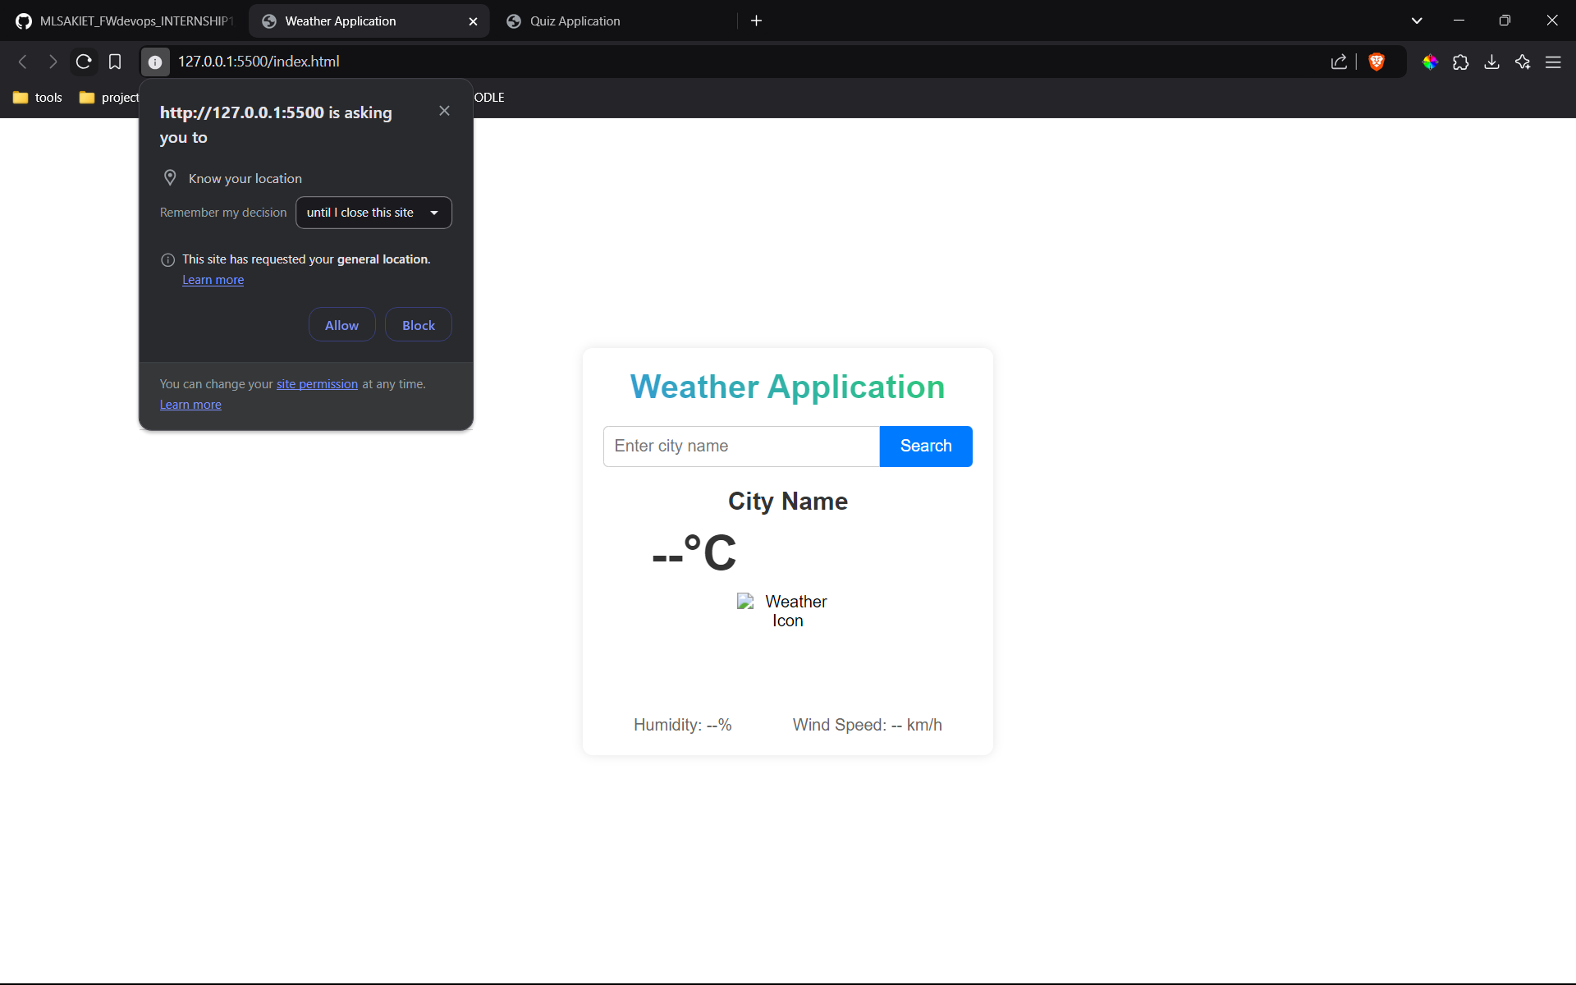

Slide 9
WEATHER APPLICATION FEATURES :
The proposed Weather Application is designed to simplify the way to get weather details about any city . These are the priority features for our project:
User-friendly Interface
Using Basic html, CSS and JS.
Accurate weather Details
Temperature in that city
Wind speed in the city
Weather Description
Humidity
Fast data Fetching
Using open weather map's api for it.

